Slide 1
Introduction to some Basic Concepts in Machine Learning

Slide 2

Machine Learning
When most people hear “Machine Learning,” they picture a robot: a dependable butler or a deadly Terminator depending on who you ask.
But Machine Learning is not just a futuristic fantasy, it’s already here.
The first ML application took over the world in the 1990s: the spam filter.

Slide 3
Agenda
Intro to Machine Learning
Workflow of a typical ML project
How to evaluate and fine-tune a ML system

Slide 4
What is Machine Learning?
Machine Learning is the science (and art) of programming computers so they can learn from data.
A general definition:
[Machine Learning is the] field of study that gives computers the ability to learn without being explicitly programmed.
—Arthur Samuel, 1959
A more engineering-oriented definition:
A computer program is said to learn from experience E with respect to some task T and some performance measure P, if its performance on T, as measured by P improves with experience E.
—Tom Mitchell, 1997

Slide 5
What is Machine Learning?
A spam filter is an ML program that given examples of spam emails and examples of regular emails (hams), can learn to flag spam.
The examples that the system uses to learn are called the training set.
The part of an ML system that learns and makes predictions is called a model.
In the spam filter case,
the task T is to flag spam for new emails,
the experience E is the training data, and
the performance measure P needs to be defined; for example, you can use the ratio of correctly classified emails (accuracy).

Slide 6
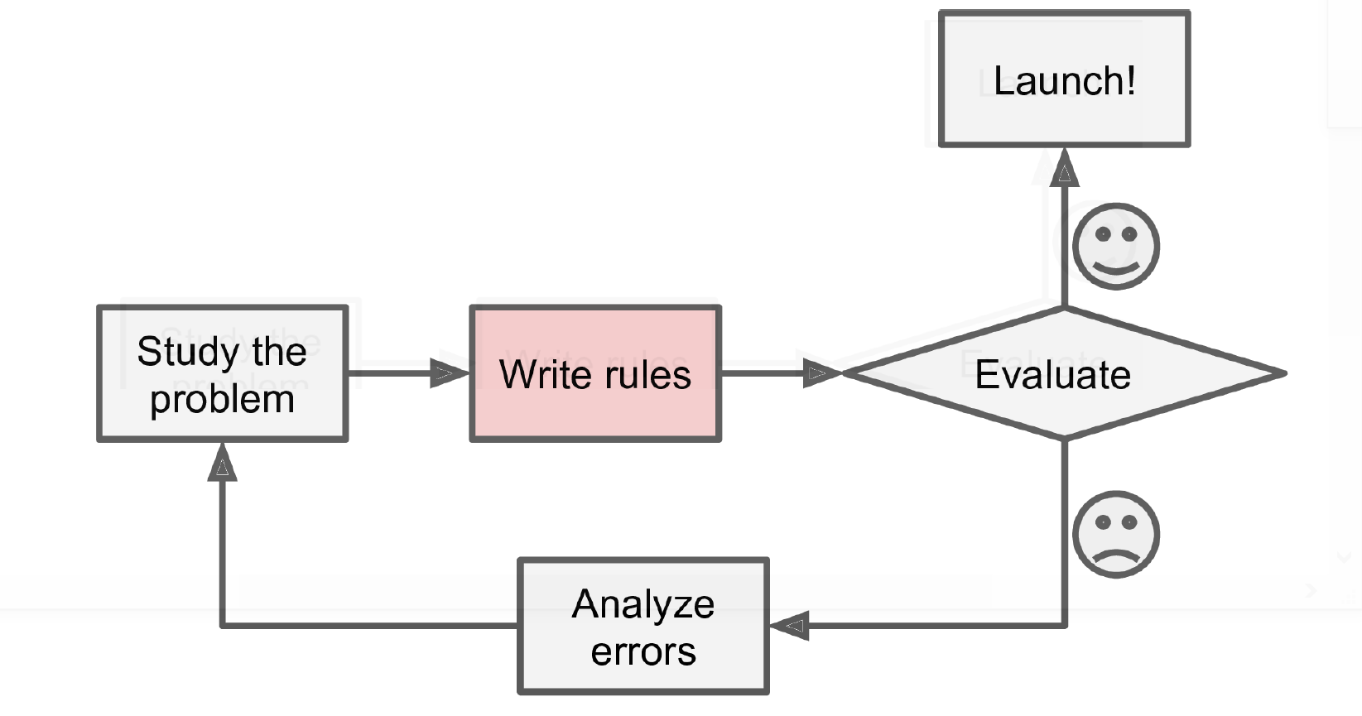
Why Use Machine Learning?
Consider how you would write a spam filter using traditional programming techniques
Since the problem is not trivial, your program will likely become a long list of complex rules—pretty hard to maintain.

Slide 7
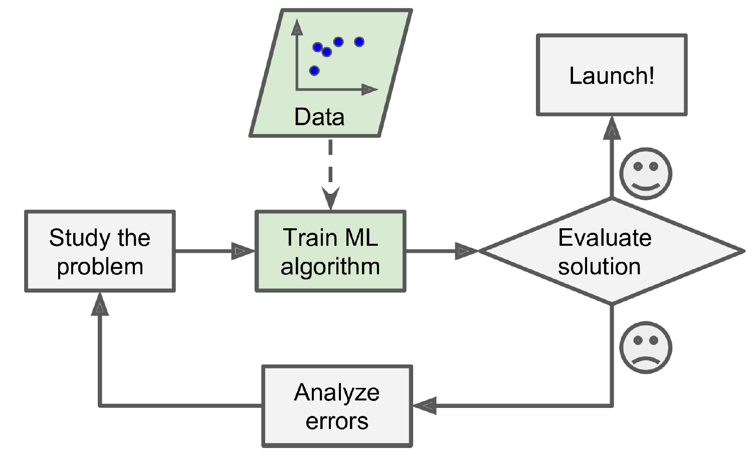
Why Use Machine Learning?
In contrast, a spam filter based on Machine Learning techniques automatically learns which words and phrases are good predictors of spam.
It detects unusually frequent patterns of words and phrases in the spam examples compared to the ham examples.

Slide 8
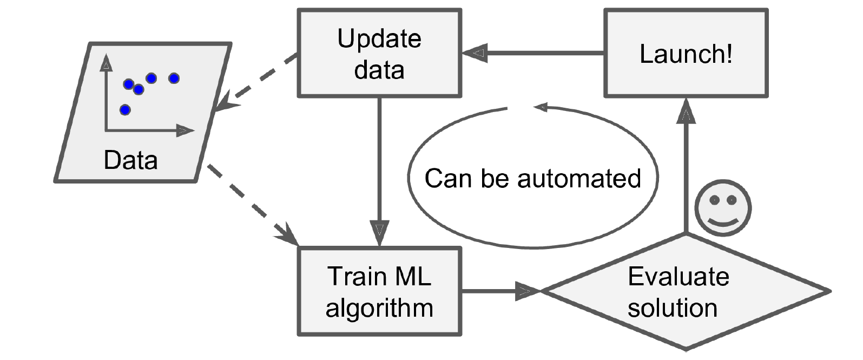
Why Use Machine Learning?
If spammers notice that all their emails containing “4U” are blocked, they might start writing “For U” instead.
Traditional programming: you will need to keep writing new rules forever.
Machine Learning techniques automatically notice and starts flagging them without intervention.

Slide 9
Why Use Machine Learning?
Another area where Machine Learning shines: is problems that either are too complex for traditional approaches or have no known algorithm.
For example, consider speech recognition.
The best solution (at least today) is to write an algorithm that learns by itself, given many example recordings for each word.

Slide 10
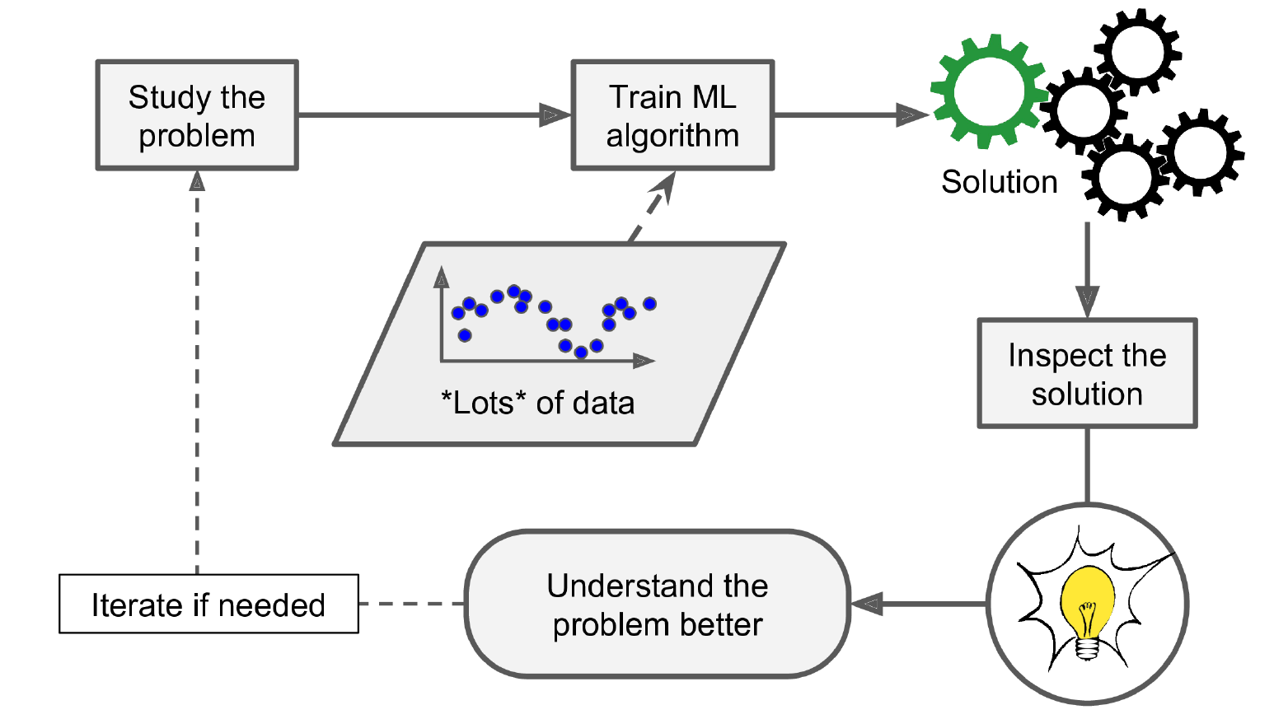
Why Use Machine Learning?
Finally, Machine Learning can help humans learn.
Digging into large amounts of data to discover hidden patterns is called data mining, and machine learning excels at it.

Slide 11
Types of Machine Learning Systems
Whether or not they are trained with human supervision
supervised, unsupervised, semi-supervised, and Reinforcement Learning
Whether or not they can learn incrementally on the fly
online versus batch learning
Whether they work by simply comparing new data points to known data points, or instead detect patterns in the training data and build a predictive model, much like scientists do
instance-based versus model-based learning
A state-of-the-art spam filter may learn on the fly using a deep neural network model trained using examples of spam and ham; this makes it an online, model-based, supervised learning system.

Slide 12
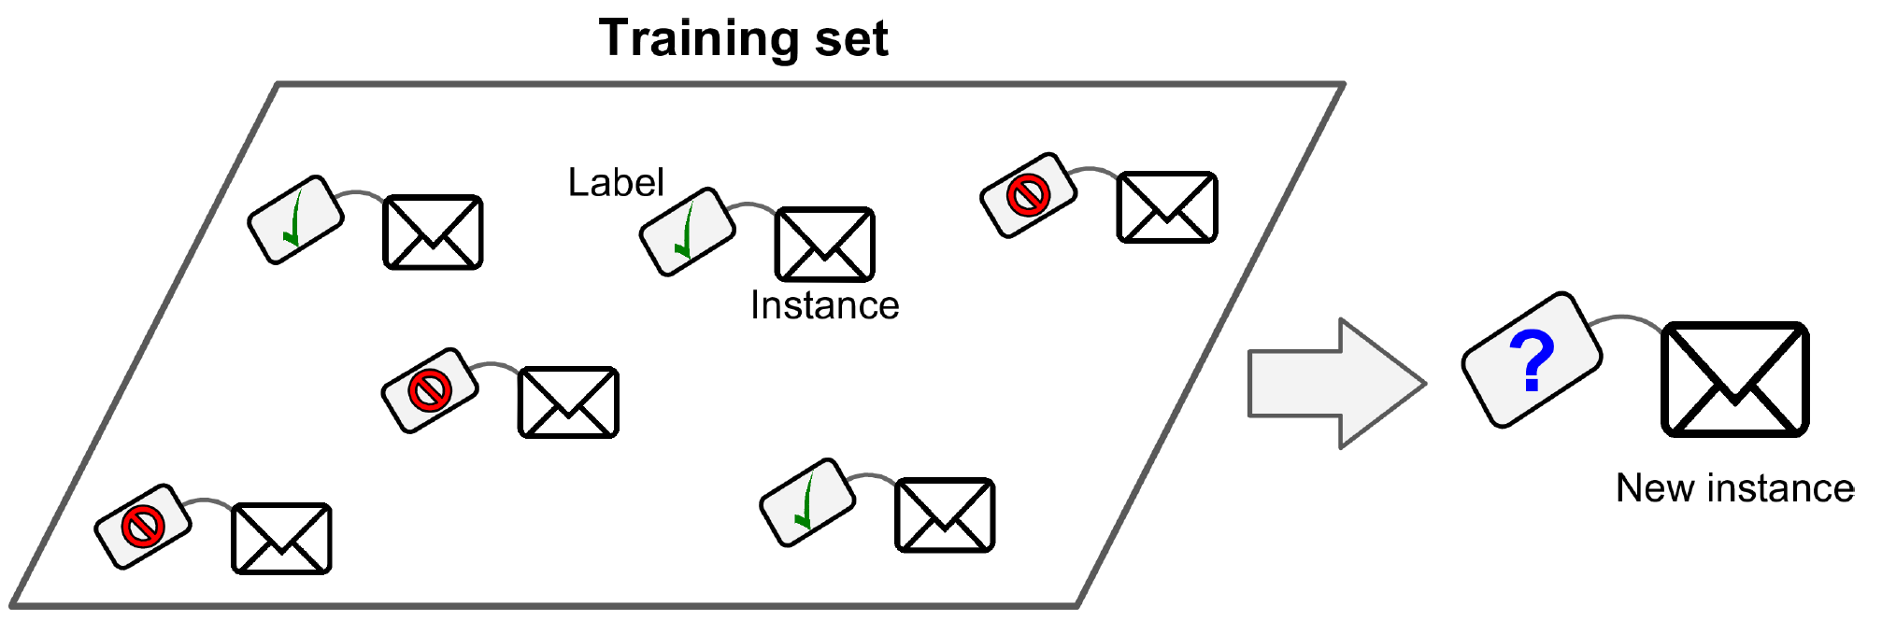
Training Supervision
Supervised learning
A typical supervised learning task is classification.

Slide 13
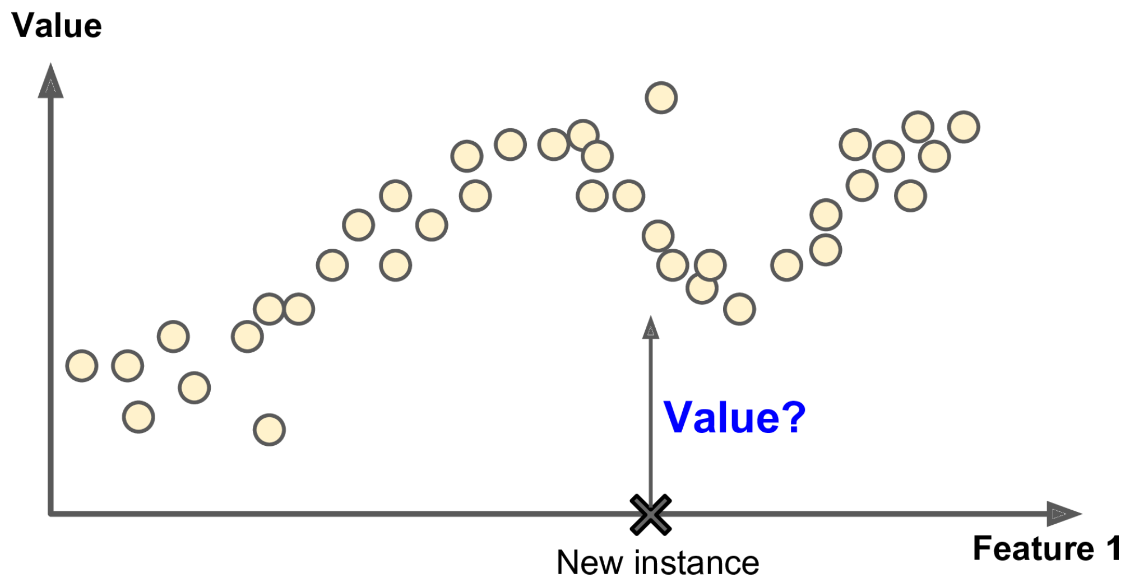
Supervised Learning
Another typical task is regression.
Note: some regression models can be used for classification as well, and vice versa.

Slide 14
Supervised Learning
Here are some of the most important supervised learning algorithms:
k-Nearest Neighbors
Linear Regression
Logistic Regression
Support Vector Machines (SVMs)
Decision Trees and Random Forests

Slide 15
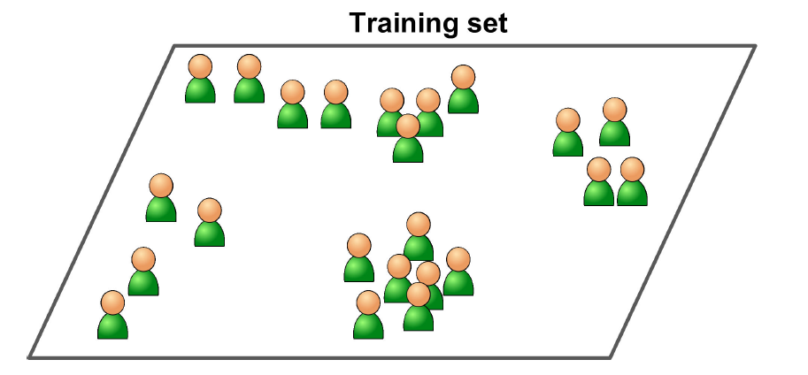
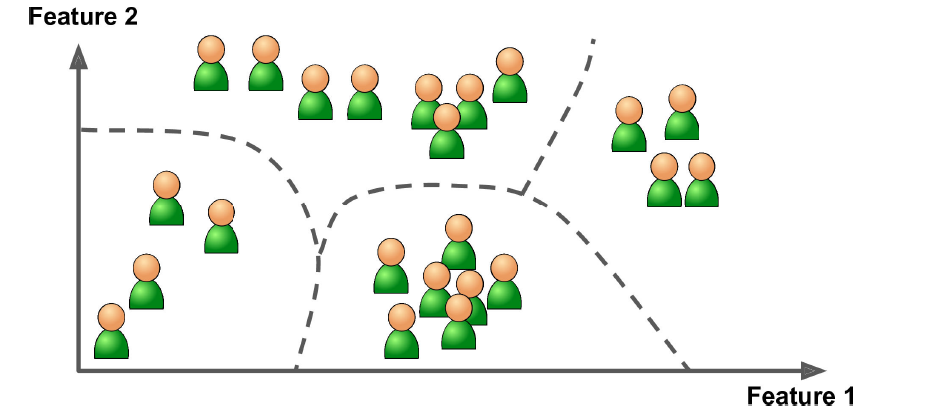
Unsupervised Learning
In unsupervised learning, the training data is unlabeled.
The system tries to learn without a teacher.
For example, clustering algorithm (detect groups of similar visitors) and hierarchical clustering algorithm (subdivide each group into smaller groups).

Slide 16
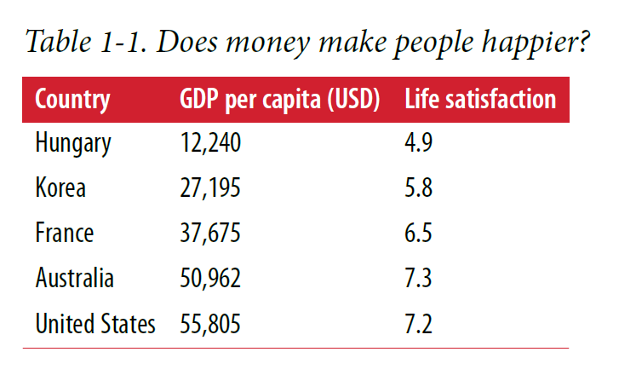
A Typical Machine Learning Workflow
For example, suppose you want to know if money makes people happy, so you download the Better Life Index data from the OECD’s website as well as stats about GDP per capita from the IMF’s website. Then you join the tables and sort by GDP per capita.

Slide 17
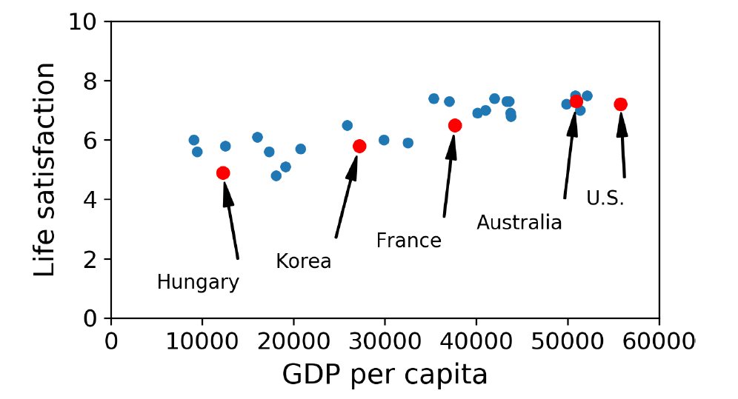
A Typical Machine Learning Workflow
Let’s plot the data for a few random countries

Slide 18
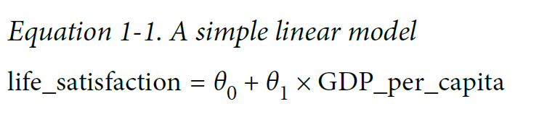
A Typical Machine Learning Workflow
There does seem to be a trend here! It looks like life satisfaction goes up linearly as the country’s GDP per capita increases.
So you decide to model life satisfaction as a linear function of GDP per capita.
This step is called model selection: you selected a linear model of life satisfaction with just one attribute, GDP per capita.

Slide 19
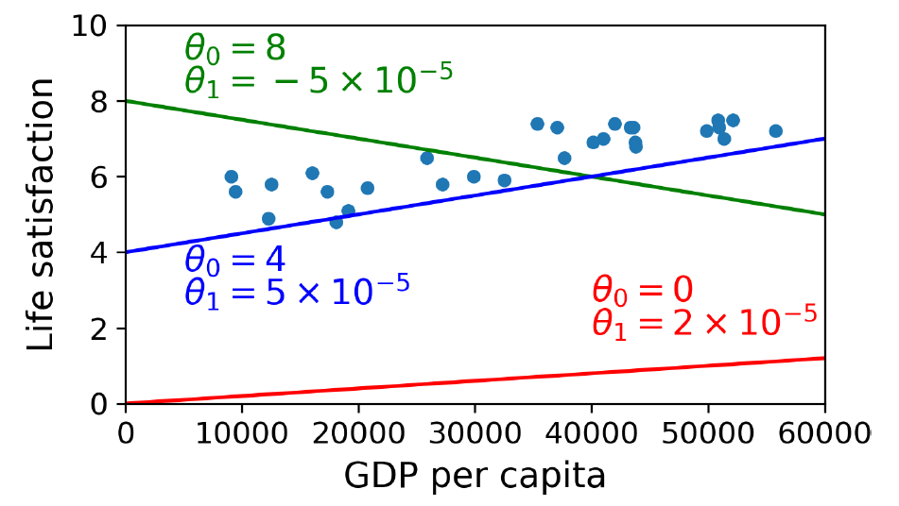
A Typical Machine Learning Workflow
This model has two model parameters, θ0 and θ1.5
By tweaking these parameters, you can make your model represent any linear function.

Slide 20
A Typical Machine Learning Workflow
How can you know which values will make your model perform best?
To answer this question, you need to specify a performance measure. You can either define a utility function (or fitness function) that measures how good your model is, or you can define a cost function that measures how bad it is.

Slide 21
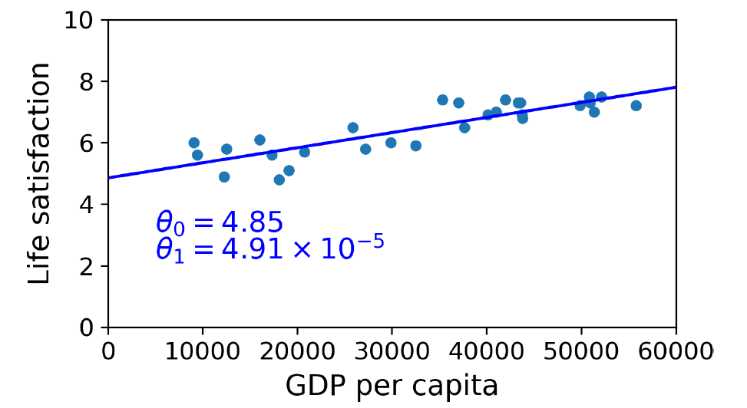
A Typical Machine Learning Workflow
Now the model fits the training data as closely as possible (for a linear model)

Slide 22
A Typical Machine Learning Workflow
You are finally ready to run the model to make predictions.
For example, say you want to know how happy Cypriots are; the OECD data does not have the answer.
Fortunately, you can use your model to make a good prediction:
Cyprus’s GDP per capita: $22,587
Apply your model 4.85 + 22,587 × 4.91 × 10-5 = 5.96.
If all went well, your model would make good predictions. If not, you may need to
use more attributes (employment rate, health, air pollution, etc.),
get more or better-quality training data, or
perhaps select a more powerful model (e.g., a Polynomial Regression model).

Slide 23
A Typical Machine Learning Workflow
In summary:
You studied the data.
You selected a model.
You trained it on the training data (i.e., the learning algorithm searched for the model parameter values that minimize a cost function).
Finally, you applied the model to make predictions on new cases (this is called inference), hoping that this model will generalize well.
This is what a typical Machine Learning project looks like.

Slide 24
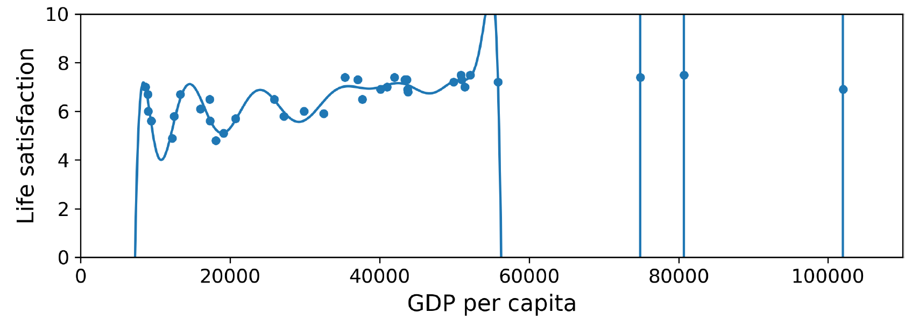
Overfitting the Training Data
Say you are visiting a foreign country and the taxi driver rips you off. You might be tempted to say that all taxi drivers in that country are thieves.
Overgeneralizing is something that we humans do all too often, and unfortunately, machines can fall into the same trap if we are not careful.

Slide 25
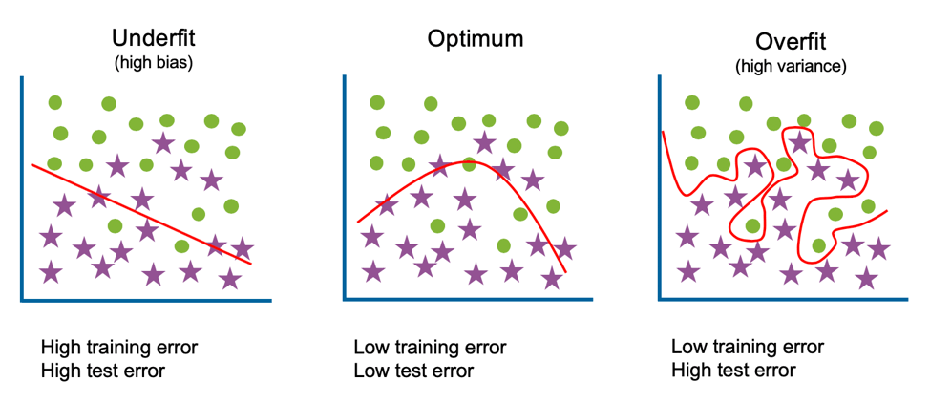
Overfitting the Training Data
Complex models such as deep neural networks can detect subtle patterns in the data, but if the training set is noisy, or if it is too small (which introduces sampling noise), then the model is likely to detect patterns in the noise itself. Obviously, these patterns will not generalize to new instances.

Slide 26
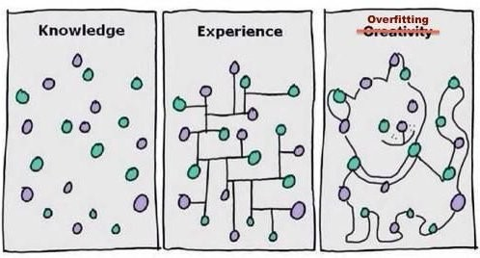
Overfitting the Training Data
For example, say you feed your life satisfaction model many more attributes, including uninformative ones such as the country’s name.
In that case, a complex model may detect patterns like the fact that all countries in the training data with a w in their name have a life satisfaction greater than 7: New Zealand (7.3), Norway (7.4), Sweden (7.2), and Switzerland (7.5).
How confident are you that the W-satisfaction rule generalizes to Rwanda or Zimbabwe?

Slide 27
Overfitting the Training Data
Overfitting happens when the model is too complex relative to the amount and noisiness of the training data.
The possible solutions are:
To simplify the model
by selecting one with fewer parameters (e.g., a linear model rather than a high-degree polynomial model),
by reducing the number of attributes in the training data, or
by constraining the model
To gather more training data
To reduce the noise in the training data (e.g., fix data errors and remove outliers)

Slide 28
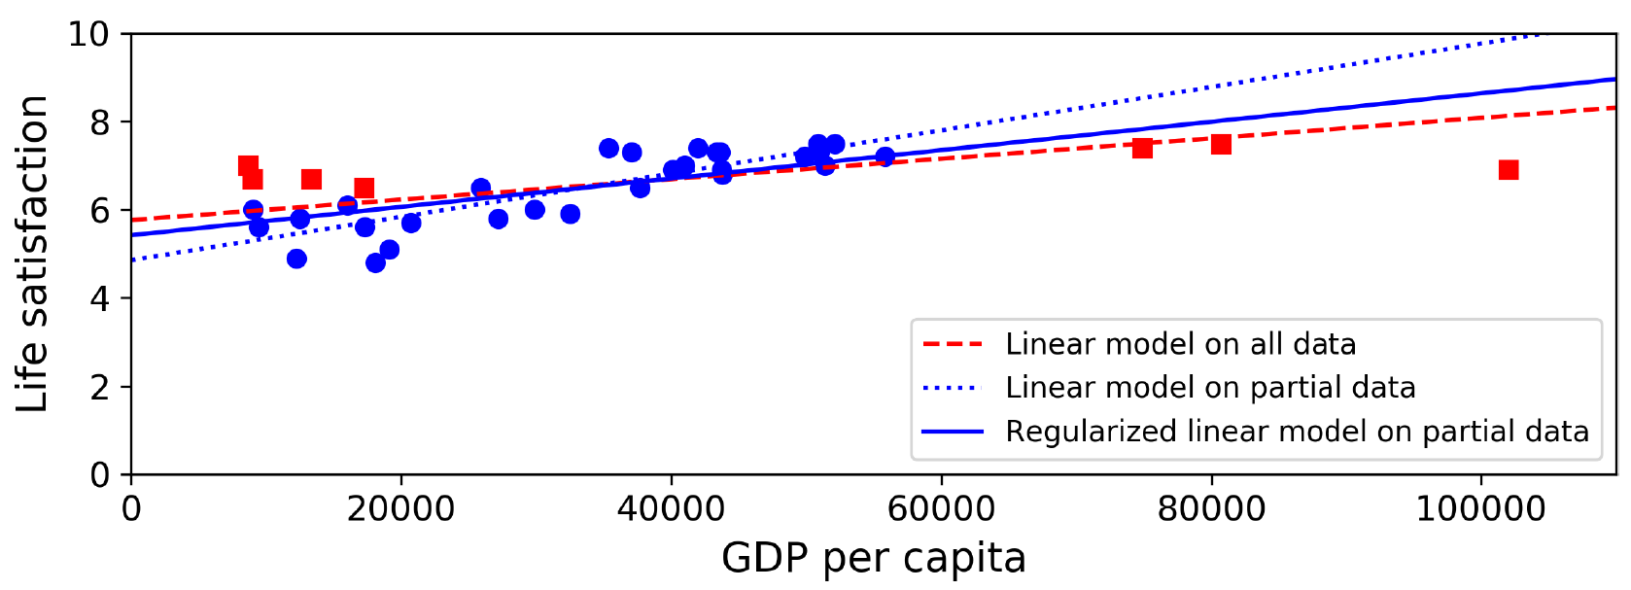
Overfitting the Training Data
Constraining a model to make it simpler and reduce the risk of overfitting is called regularization.
The amount of regularization to apply during learning can be controlled by a hyperparameter. A hyperparameter is a parameter of a learning algorithm (not of the model).
Tuning hyperparameters is an important part of building a Machine Learning system

Slide 29
Underfitting the Training Data
Underfitting is the opposite of overfitting: it occurs when your model is too simple to learn the underlying structure of the data.
The main options to fix this problem are:
Selecting a more powerful model, with more parameters
Feeding better features to the learning algorithm (feature engineering)
Reducing the constraints on the model (e.g., reducing the regularization hyperparameter)

Slide 30
Testing and Validating
The only way to know how well a model will generalize to new cases is to actually try it out on new cases.
One way to do that is to put your model in production and monitor how well it performs.
This works well, but if your model is horribly bad, your users will complain—not the best idea.

Slide 31
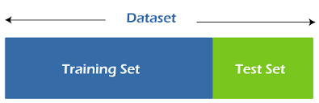
Testing and Validating
A better option is to split your data into two sets: the training set and the test set.
As these names imply, you train your model using the training set, and you test it using the test set.
The error rate on new cases is called the generalization error (or out-of-sample error), and by evaluating your model on the test set, you get an estimate of this error.
This value tells you how well your model will perform in instances it has never seen before.

Slide 32
Hyperparameter Tuning and Model Selection
Evaluating a model is simple enough: just use a test set.
Now suppose you are hesitating between two models (say a linear model and a polynomial model): how can you decide?
One option is to train both and compare how well they generalize using the test set.

Slide 33
Hyperparameter Tuning and Model Selection
Now suppose that the linear model generalizes better, but you want to apply some regularization to avoid overfitting.
The question is: how do you choose the value of the regularization hyperparameter?
One option is to train 100 different models using 100 different values for this hyperparameter.
Suppose you find the best hyperparameter value that produces a model with the lowest generalization error, say just a 5% error.
So you launch this model into production, but unfortunately it does not perform as well as expected and produces 15% errors.
What just happened?

Slide 34

Hyperparameter Tuning and Model Selection
The problem is that you measured the generalization error multiple times on the test set and adapted the model and hyperparameters to produce the best model for that particular set.
This means the model is unlikely to perform well on new data.

Slide 35
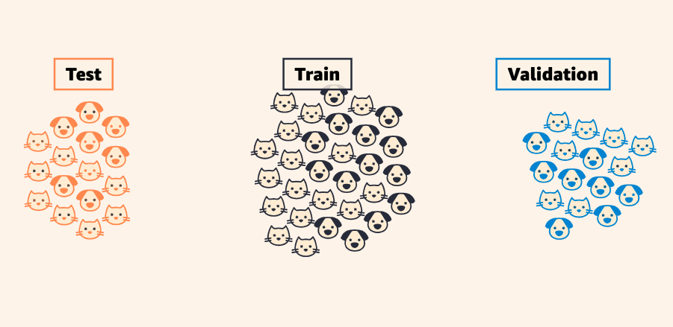
Holdout Validation
A common solution to this problem is holdout validation: simply hold out part of the training set to evaluate several candidate models and select the best one.
The new heldout set is called the validation set (or sometimes the development or dev set).

Slide 36
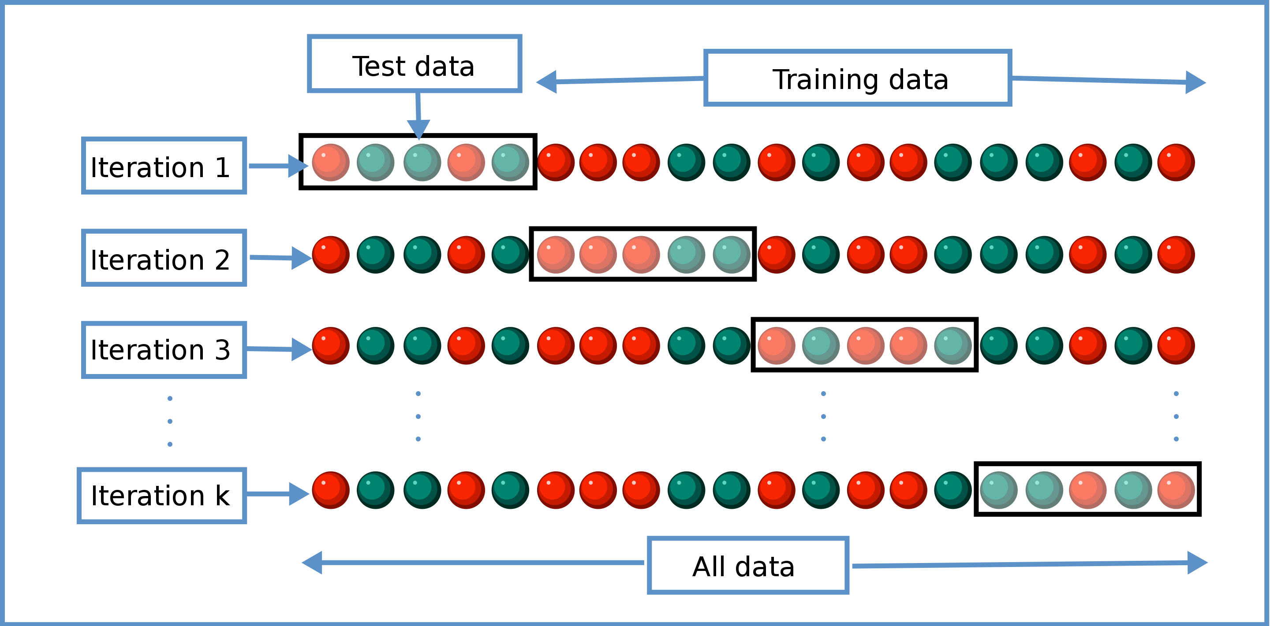
Cross-Validation
This solution usually works quite well. However, if the validation set is too small, then model evaluations will be imprecise: you may end up selecting a suboptimal model by mistake.
One way to solve this problem is to perform repeated cross-validation, using many small validation sets.
Each model is evaluated once per validation set after it is trained on the rest of the data.
By averaging out all the evaluations of a model, we get a much more accurate measure of its performance.
There is a drawback: the training time is multiplied by the number of validation sets.

